Slide 1
CH.3. BEGINNING WITH C++

Slide 2
Objectives
To learn the following concepts
HISTORY OF C++
Basic C++ program structure
Few editors for C++ compilation
Various Input and Output operations
Program life cycle model
C++ program development environment
Writing simple C++ programs

Slide 3
History of C++
1978- C language was developed by Dennis Ritchie and Brain Kernighan.
1979- C++ was developed by Bjarne Stroustrup at Bell Labs and provides object-oriented capabilities .
Object-oriented design is very powerful.
Dominant language in industry and academia.
Notes:
Additional information about history of C and C++
The C++ programming language has a history going back to 1979, when Bjarne Stroustrup was doing work for his Ph.D. thesis. One of the languages Stroustrup had the opportunity to work with was a language called Simula, which as the name implies is a language primarily designed for simulations. The Simula 67 language - which was the variant that Stroustrup worked with - is regarded as the first language to support the object-oriented programming paradigm. Stroustrup found that this paradigm was very useful for software development;
However the Simula language was far too slow for practical use. Shortly thereafter, he began work on "C with Classes", which as the name implies was meant to be a superset of the C language. His goal was to add object-oriented programming into the C language, which was and still is a language well-respected for its portability without sacrificing speed or low-level functionality. His language included classes, basic inheritance, inlining, default function arguments, and strong type checking in addition to all the features of the C language. The first C with Classes compiler was called Cfront, which was derived from a C compiler called CPre. It was a program designed to translate C with Classes code to ordinary C. A rather interesting point worth noting is that Cfront was written mostly in C with Classes, making it a self-hosting compiler (a compiler that can compile itself).
Cfront would later be abandoned in 1993 after it became difficult to integrate new features into it, namely C++ exceptions. Nonetheless, Cfront made a huge impact on the implementations of future compilers and on the Unix operating system. In 1983, the name of the language was changed from C with Classes to C++. The ++ operator in the C language is an operator for incrementing a variable, which gives some insight into how Stroustrup regarded the language. Many new features were added around this time, the most notable of which are virtual functions, function overloading, references with the & symbol, the const keyword, and single-line comments using two forward slashes (which is a feature taken from the language BCPL).

Slide 4
Features of C++ language
C++ programming language is highly flexible, versatile and very powerful.
It is well suited for developing system softwares like operating system, compilers etc.
It is most suited for development of reusable programs.
We can develop new user defined data types called classes.
We can give new meanings to operators using operator overloading.
It provides a very rich set of unique features like encapsulation, polymorphism and inheritance.
Notes:
Additional information on various C++ releases
In 1985, Stroustrup's reference to the language entitled The C++ Programming Language was published. That same year, C++ was implemented as a commercial product. The language was not officially standardized yet, making the book a very important reference. The language was updated again in 1989 to include protected and static members, as well as inheritance from several classes. In 1990, The Annotated C++ Reference Manual was released. The same year, Borland's Turbo C++ compiler would be released as a commercial product. Turbo C++ added a plethora of additional libraries which would have a considerable impact on C++'s development. Although Turbo C++'s last stable release was in 2006, the compiler is still widely used.
In 1998, the C++ standards committee published the first international standard for C++ ISO/IEC 14882:1998, which would be informally known as C++98. The Annotated C++ Reference Manual was said to be a large influence in the development of the standard. The Standard Template Library, which began its conceptual development in 1979, was also included.
In 2003, the committee responded to multiple problems that were reported with their 1998 standard, and revised it accordingly. The changed language was dubbed C++03. In 2005, the C++ standards committee released a technical report (dubbed TR1) detailing various features they were planning to add to the latest C++ standard. The new standard was informally dubbed C++0x as it was expected to be released sometime before the end of the first decade. Ironically, however, the new standard would not be released until mid-2011.
Several technical reports were released up until then, and some compilers began adding experimental support for the new features. In mid-2011, the new C++ standard (dubbed C++11) was finished. The Boost library project made a considerable impact on the new standard, and some of the new modules were derived directly from the corresponding Boost libraries. Some of the new features included regular expression support (details on regular expressions may be found here), a comprehensive randomization library, a new C++ time library, atomics support, a standard threading library (which up until 2011 both C and C++ were lacking), a new for loop syntax providing functionality similar to for each loops in certain other languages, the auto keyword, new container classes, better support for unions and array-initialization lists, and variadic templates.

Slide 5
Editor: Turbo C++
Menu Options:
File : New, Open(F3), Save(F2), Save as, Change dir, Quit(Alt + x)
Edit : Undo, Redo, Cut, Copy, Paste
Run : Run(Ctrl + F9), Trace into(F7), Step Over(F8)
Break-point (Ctrl+F8)
Compile : Compile(Alt + F9)
Debug : Watch window (add watch (Ctrl+F7), delete watch, Edit watch, remove all watches)
Windows : User Screen( Alt + F5)
Help : <Ctrl> F1 or right click (keep cursor on the word)

Slide 6
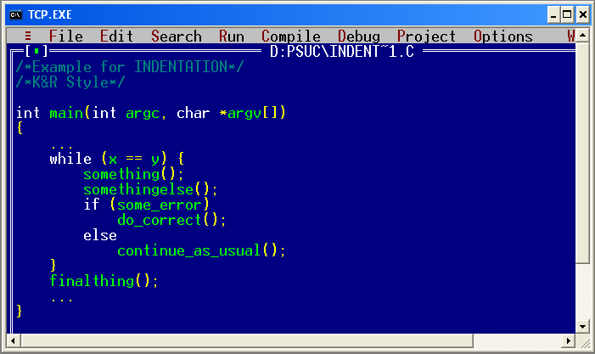
Editor: Turbo C++
Notes:
Additional information on Turbo C++
Turbo C++ was a C++ compiler and integrated development environment and computer language originally from Borland. Most recently it was distributed by Embarcadero Technologies, which acquired all of Borland's compiler tools with the purchase of its Code Gear division in 2008. The original Turbo C++ product line was put on hold after 1994, and was revived in 2006 as an introductory-level IDE, essentially a stripped-down version of their flagship C++ Builder. Turbo C++ 2006 was released on September 5, 2006 and was available in 'Explorer' and 'Professional' editions. The Explorer edition was free to download and distribute while the Professional edition was a commercial product. In October 2009 Embarcadero Technologies discontinued support of its 2006 C++ editions. As such, the Explorer edition is no longer available for download and the Professional edition is no longer available for purchase from Embarcadero Technologies. Turbo C++ is succeeded by C++ Builder.

Slide 7
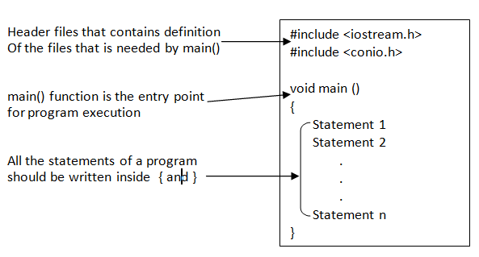
Basic structure of a C++ program

Slide 8
A Simple C++ program
1 // Program: Demo.cpp
2 // Printing welcome statement for users.
3
#include <iostream>
4 using namespace std;
5 // function main begins program execution
6 int main()
7 {
8 cout << "Welcome to C++ ";
9 } // end function main
Output: Welcome to C++!

Slide 9
A Simple C++ program
1 // Program: Demo1.cpp
2 // Printing multiple lines with a single statement
3 #include <iostream>
4 using namespace std;
5 // function main begins program execution
6 int main()
7 {
cout << "Welcome \n to \n \n C++!\n";
} // end function main
Using newline characters to print on multiple lines.
Output:
Welcome
to
C++!

Slide 10
#include <iostream.h>
Lines beginning with a sign (#) are called as preprocessor directives.
Ex:- #include
The preprocessor directives are always executed first by the preprocessor , before executing the actual program statements.
The directive #include tells the preprocessor to include the iostreamstandard header file for the program.
iostream includes the declarations of the basic standard input-output library in C++.
Notes:
Additional information on few preprocessor directives
#include<conio.h>
conio.h is Turbo C++ header file from Borland. It is used for clrscr(), getch() functions..
#include<math.h>
Used for mathematics related operations. (Eg. To compute square root etc.)

Slide 11
int main ()
The main function is the point where all C++ programs start their execution, independently of its location within the source code.
It is essential that all C++ programs have a main() function.
The word main is followed in the code by a pair of parentheses (). That is because it is a function declaration.
Optionally, these parentheses may enclose a list of parameters within them.
Right after these parentheses we can find the body of the main function enclosed in braces{ }.
Notes:
Additional information – main ()
In many programming languages, the main function is where a program starts execution. It is responsible for the high-level organization of the program's functionality, and typically has access to the command arguments given to the program when it was executed.

Slide 12
cout / cin statements
The operator << is known as insertion or put to operator.
cout represents the standard output stream in C++.
cout inserts a sequence of characters into the standard output stream (which is usually the screen).
Ex:- cout<<“welcome to MIT”;
The operator >> is known as extraction or get from operator.
It extracts the value from keyboard & assign it to the variable on its right.
Ex:- cin>> name;

Slide 13
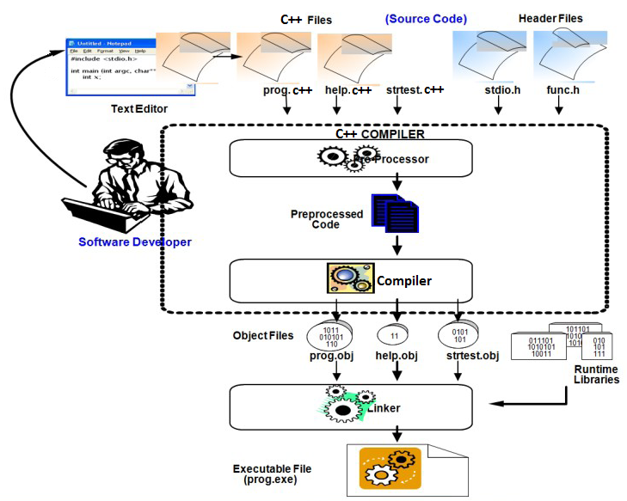
Program Life Cycle
Notes:
Additional notes on program life cycle
The diagram above depicts the various phases involved in the program life cycle.
Editing Phase: The first step in writing a program is to create source code files with the code statements in header files (.h files) and source files (.c files). The code statements are entered into the files using a standard editor (Visual Studio in our case). Care must be taken to enter the code such that it is properly formatted and follows programming standards. Since a program is the most detailed design specifications it must be easily understandable.
Preprocessing and compiling phase: When the compiler is invoked the preprocessor runs first to create the compiler input. The compiler then scans the entire source code for any syntax errors and creates an OBJ file containing linker directives, external references etc.
If there are any syntax errors the code is edited and recompiled. It is a good practice to review the code once the code passes the compilation stage to locate logic errors and ensure conformance to standards

Slide 14
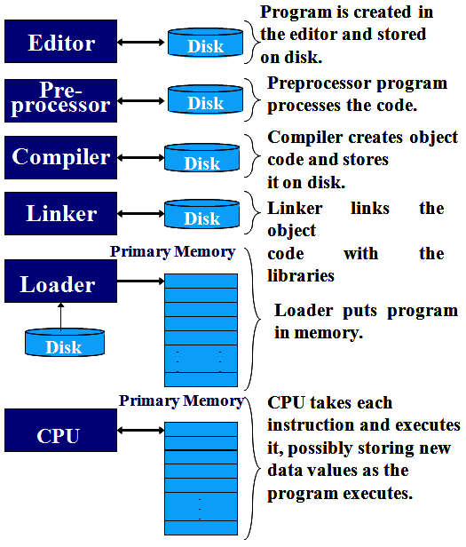
Typical C++ Program Development Environment
Phases of C++ Program execution:
Edit
Preprocess
Compile
Link
Load
Execute
Notes:
Additional notes on program development environment
Assembler: A computer will not understand any program written in a language, other than its machine language. The programs written in other languages must be translated into the machine language. Such translation is performed with the help of software. A program which translates an assembly language program into a machine language program is called an assembler. If an assembler which runs on a computer and produces the machine codes for the same computer then it is called self-assembler or resident assembler. If an assembler that runs on a computer and produces the machine codes for other computer then it is called Cross Assembler.
Assemblers are further divided into two types: One Pass Assembler and Two Pass Assembler. One pass assembler is the assembler which assigns the memory addresses to the variables and translates the source code into machine code in the first pass simultaneously. A Two Pass Assembler is the assembler which reads the source code twice. In the first pass, it reads all the variables and assigns them memory addresses. In the second pass, it reads the source code and translates the code into object code.
Compiler: It is a program which translates a high level language program into a machine language program. A compiler is more intelligent than an assembler. It checks all kinds of limits, ranges, errors etc. But its program run time is more and occupies a larger part of the memory. It has slow speed. Because a compiler goes through the entire program and then translates the entire program into machine codes. If a compiler runs on a computer and produces the machine codes for the same computer then it is known as a self-compiler or resident compiler. On the other hand, if a compiler runs on a computer and produces the machine codes for other computer then it is known as a cross compiler.
Interpreter: An interpreter is a program which translates statements of a program into machine code. It translates only one statement of the program at a time. It reads only one statement of program, translates it and executes it. Then it reads the next statement of the program again translates it and executes it. In this way it proceeds further till all the statements are translated and executed. On the other hand, a compiler goes through the entire program and then translates the entire program into machine codes. A compiler is 5 to 25 times faster than an interpreter.
By the compiler, the machine codes are saved permanently for future reference. On the other hand, the machine codes produced by interpreter are not saved. An interpreter is a small program as compared to compiler. It occupies less memory space, so it can be used in a smaller system which has limited memory space.
Linker: In high level languages, some built in header files or libraries are stored. These libraries are predefined and these contain basic functions which are essential for executing the program. These functions are linked to the libraries by a program called Linker. If linker does not find a library of a function then it informs to compiler and then compiler generates an error. The compiler automatically invokes the linker as the last step in compiling a program.
Not built in libraries, it also links the user defined functions to the user defined libraries. Usually a longer program is divided into smaller subprograms called modules. And these modules must be combined to execute the program. The process of combining the modules is done by the linker.
Loader: Loader is a program that loads machine codes of a program into the system memory. In Computing, a loader is the part of an Operating System that is responsible for loading programs. It is one of the essential stages in the process of starting a program. Because it places programs into memory and prepares them for execution. Loading a program involves reading the contents of executable file into memory. Once loading is complete, the operating system starts the program by passing control to the loaded program code. All operating systems that support program loading have loaders. In many operating systems the loader is permanently resident in memory.

Slide 15
Simple C++ Programs

Slide 16
Read and display a number
#include<iostream> // header file for input/output
using namespace std;
int main() //main function
{ //program body begins
int number; //variable declaration
cout<<“Enter number “; // user friendly info display
cin>>number; // reading input value to the variable
cout<<“The entered no. is\n”<<number; //writing or output variable value
} // end of program
Notes:
16

Slide 17
Converting the given Seconds into hr., min. & sec.
Notes:
17

Slide 18
Converting the given Seconds into hr., min. & sec.
#include<iostream>
using namespace std;
Int main( )
{
int seconds, hours, minutes;
cout<<“enter seconds”;
cin>>seconds;
hours= seconds/3600;
seconds = seconds % 3600;
minutes= seconds/60;
seconds= seconds % 60;
cout<<“\n”<<“ Given Seconds = “ <<hours<<“ hrs : “<<minutes<<“ mins : “ <<seconds <<“ secs”;
}
Notes:
18

Slide 19
Convert Cel. to Fahren. & vice versa
Notes:
19

Slide 20
Convert Cel. to Fahren. & vice versa
#include<iostream>
using namespace std;
int main()
{
float fahrenheit , celsius;
cout<<“enter temperature in Celsius”;
cin>>celsius;
fahrenheit=(9.0 / 5.0) * celsius + 32.0;
cout<<“fahrenheit =“<<fahrenheit;
cout<<“enter temperature in fahrenheit “;
cin>>fahrenheit;
cel=(fahrenheit – 32) * (5.0 / 9);
cout<<“celsius= “<<celsius;
}
Notes:
20

Slide 21
Exchange memory variables a, b without 3rd variable
# include<iostream>
using namespace std;
int main( )
{
int a,b;
clrscr();
cout<<"enter 2 numbers: ";
cin>>a>>b;
a=a + b;
b=a-b;
a=a-b;
cout<<"after interchange the values are<<a<<"\t"<<b;
}
Notes:
21

Slide 22
Sum of digits of a 4-digit number
#include<iostream.h>
using namespace std;
int main()
{
int num, digit, sum=0;
cout<<“enter 4 digit no.”;
cin>>num;
digit= num%10;
num=num/10;
sum=sum + digit;
digit= num%10;
num=num/10;
sum=sum + digit;
digit= num%10;
num=num/10;
sum=sum + digit + num;
cout<<“\n”<<“sum of digits=“<<sum;
}
Notes:
22

Slide 23
Identify the errors
#include <iostream>
using namespace std;
Int main()
{ int R, C;
float perimeter area;
C = PI
R = 5;
perimeter = 2.0*C*R;
area = C * R * R;
cout<< perimeter << area;
}

Slide 24
Summary
HISTORY OF C++
Basic C++ program structure
Few editors for C++ compilation
Various Input and Output operations
Program life cycle model
C++ program development environment
Writing simple C++ programs

